Slide 1
Unit 6
IMAGE ANALYSIS
Hour:[9 hrs]
Presented by
Er.Harendra Bikram Shah (Lecturer)
Department of Computer Engineering
NAST

Slide 2
OUTLINES
6.1 Introduction to Image Analysis
6.2 Feature Extraction & Types of Features, Detection of Discontinuities
6.3 Segmentation: Discontinuities-based segmentation ( Point detection, line detection, Edge detection)
6.4 Similarities-based segmentation
6.4 .1 Feature Thresholding
6.4.1.1 Amplitude Thresholding
6.4.1.2.Thresholding based upon histogram statistics
6.4.1.3. Multi-level Thresholding
6.4.1.4. Local & Global Thresholding
6.4.1.5. Optimum Thresholding
6.4.2 Region growing based segmentation: seeded and unseeded
6.4.3 Region splitting& Merging
6.5 Region Description & representation
6.5.1Crack code & chain code
6.5.2 Polygon Approximation
6.5.3 Signatures
6.5.4 Shape Numbers
6.5.5 Fourier Descriptors

Slide 3
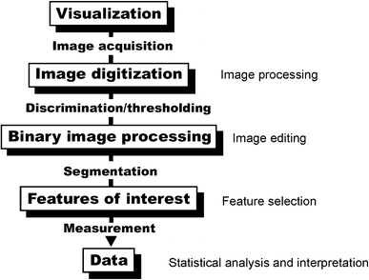
INTRODUCTION TO IMAGE ANALYSIS
It involves the extraction of meaningful information from images, enabling understanding, interpretation, and manipulation.

Slide 4
INTRODUCTION TO IMAGE ANALYSIS
Application Area | Image Analysis Role
Medical Imaging | Disease diagnosis, organ measurement
Security & Surveillance | Face/motion detection
Agriculture | Crop monitoring, disease detection
Industry | Quality inspection, robot guidance
Remote Sensing | Land use, disaster impact
AI & Machine Learning | Feature extraction, model input

Slide 5
Feature Extraction & Types of Features, Detection of Discontinuities
Image feature extraction involves identifying and representing distinctive structures within an image.
Features are characteristics of an image that help distinguish one image from another
Importance of Feature Extraction in Image Processing
Dimensionality Reduction
Improved Accuracy:
Enhanced Performance:
Noise Reduction:
Types of Features
Low-Level Features (directly extracted from the image):
Edges: Rapid changes in intensity.
Corners: Intersection of two edges.
Blobs: Regions of similar intensity.
Texture: Patterns of variation in pixel intensity.
Color: Based on RGB, HSV, etc.
High-Level Features (semantic features):
Shapes (e.g., circles, rectangles)
Objects (cars, humans)
Faces, expressions

Slide 6
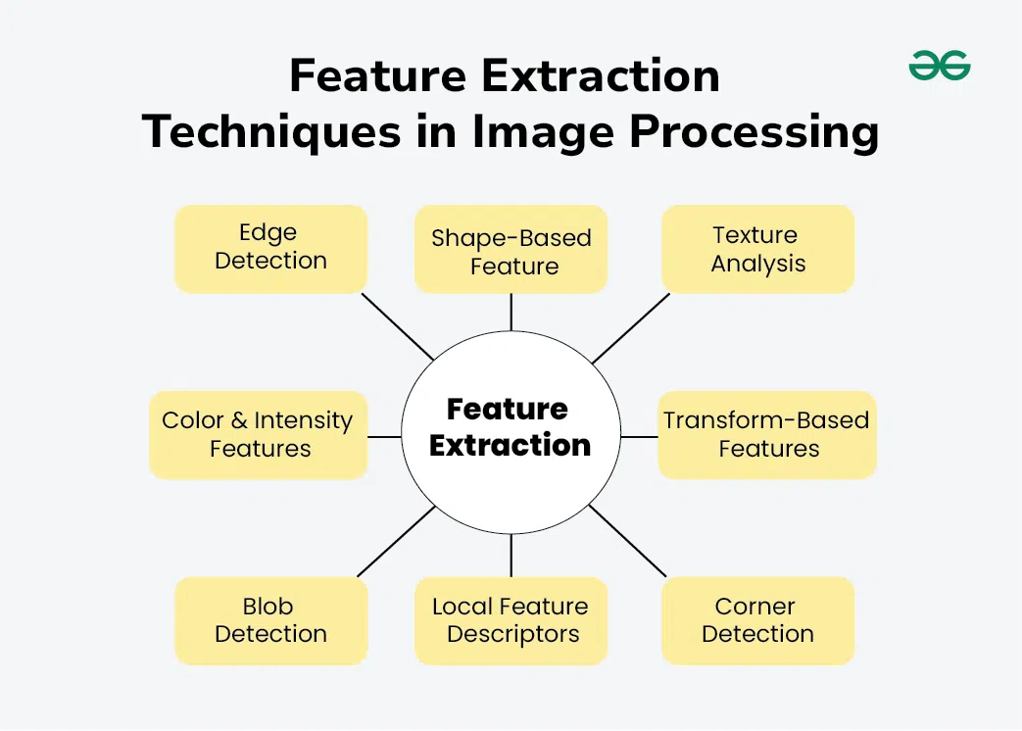
Techniques of Feature Extraction

Slide 7
Techniques of Feature Extraction
Common edge detection methods are:
Sobel, Prewitt and Robert Operator
Canny Edge Detector
Common corner detection methods are:
Harris Corner Detector
Shi-Tomasi Corner Detector
Common blob detection methods:
Laplacian of Gaussian
Difference of Gaussian
Determinant of Hessian

Slide 8
Techniques of Feature Extraction
Common texture analysis methods:
Gray-level Co-occurance Matrix:
Local Binary Patterns:
Gabor Filters:
Common Color and Intensity Features Methods Include:
Color Histograms
Color Moments
Color Coherence Vector
some common transform-based methods:
Fourier Transform
Wavelet Transform
Discrete Cosine Transform

Slide 9
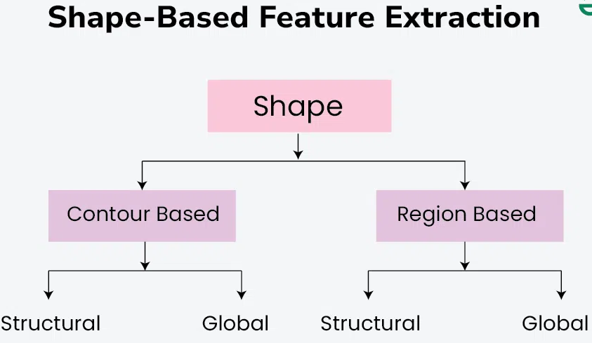
Common local feature descriptors Methods are:
Scale invariant Feature Transform (SIFT)
Speeded Up Robust Feature (SURF)
Oriented Fast and Rotated Brief(ORB)

Slide 10
Applications of Feature Extraction for Image Processing
Object Recognition
Facial Recognition
Medical Imaging
Remote Sensing
Content-Based Image Retrieval (CBIR

Slide 11
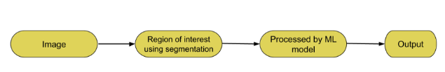
INTRODUCTION TO IMAGE SEGMENTATION
Task that involves dividing an image into meaningful and distinct regions or segments.
The goal is to simplify or change the representation of an image into something that is more meaningful and easier to analyze.
Image segmentation on the basis of two properties:
discontinuity
similarity

Slide 12
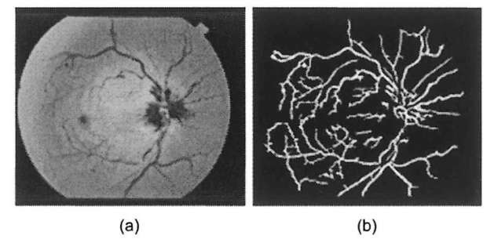
Introduction to Image Segmentation
Applications:
Medical Imaging:
Autonomous Vehicles:
Satellite Image Analysis:
Robotics:
Video Surveillance:
Biometrics:
Agriculture:
Remote Sensing:

Slide 13
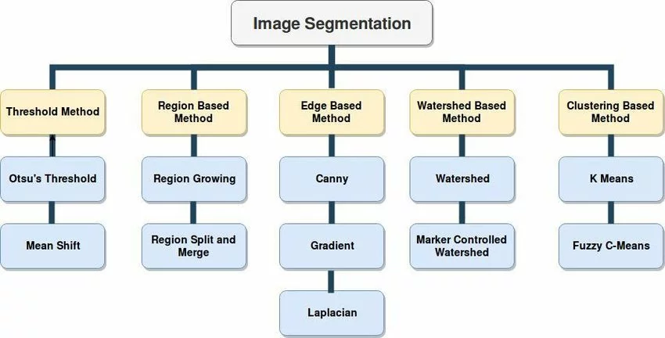
Image Segmentation Based on Similarity Properties
Thresholding: to separate objects or regions.
Region-Based Segmentation: Groups pixels based on their similar properties, like intensity, Color, or texture.
Edge-Based Segmentation: Identifies boundaries (edges) between different regions in an image.
Clustering-Based Segmentation: Groups pixels into clusters based on their similarity in feature space.
Watershed Segmentation: uses topographic information to divide an image into multiple segments or regions.

Slide 14
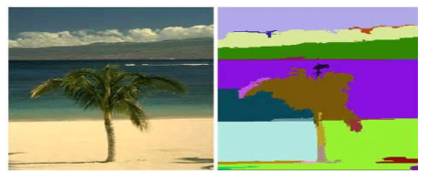
Image Segmentation Based on Region
They are two types
Region growing
Recursively grows segments by including neighbouring pixels with similar characteristics.
It uses the difference in gray levels for gray regions and the difference in textures for textured images.

Slide 15
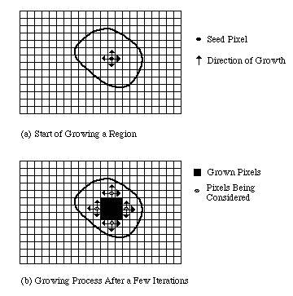
Image Segmentation Based on Region

Slide 16
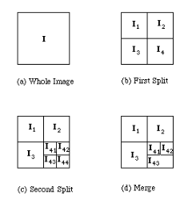
Image Segmentation Based on Region Splitting and Merging
Region splitting −
In this method, the whole image is considered a single region.
Now to divide the region into segments it checks for pixels included in the initial region if they follow the predefined set of criteria.
If they follow similar rules they are taken into one segment.

Slide 17
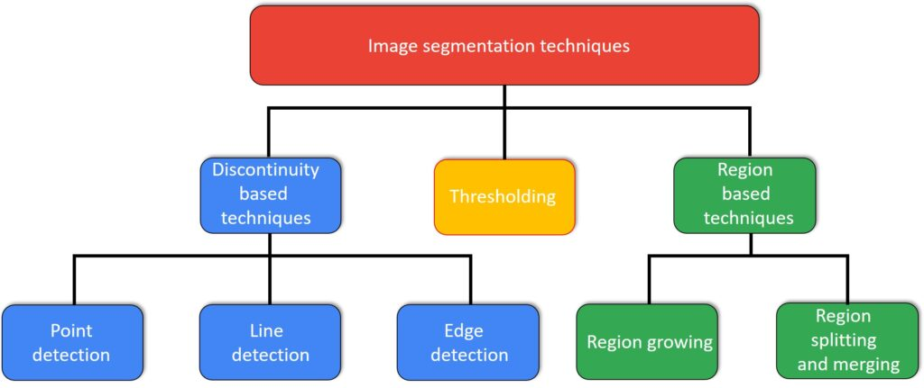
Image Segmentation Based on Dissimilar Properties

Slide 18
Image Segmentation Based on Dissimilar Properties
Uses information about edges in an image to sketch boundaries between different regions or objects.
Edges are areas where there are significant changes in intensity or Color, and identifying them is crucial for image segmentation.
Edge Detection : edge detection algorithms to highlight areas of rapid intensity changes.
Common edge detection methods include:
Using Mask(Operator):
Sobel Operator:
Prewitt Operator:
Robert Operator
Template Matching
Compass Operator
Edge Linking:
Connect the detected edge points to form continuous curves or contours.
Techniques for edge linking include Hough Transform, region-growing, and chain codes.
Hough Transform, for example, can be used to link edge points into lines or curves by identifying common parameters.

Slide 19
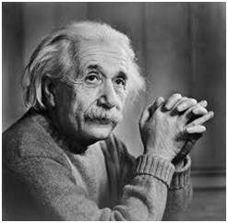
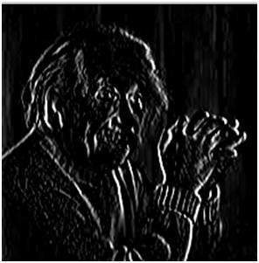
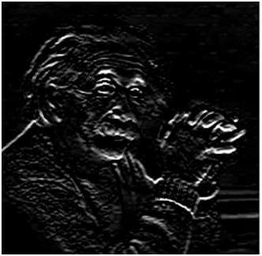
Prewitt operator
Prewitt operator is used for edge detection in an image.
It detects two types of edges
Horizontal edges
Vertical Edges
Edges are calculated by using difference between corresponding pixel intensities of an image.
Vertical direction
Horizontal Direction
-1 | 0 | 1
-1 | 0 | 1
-1 | 0 | 1
-1 | -1 | -1
0 | 0 | 0
1 | 1 | 1

Slide 20
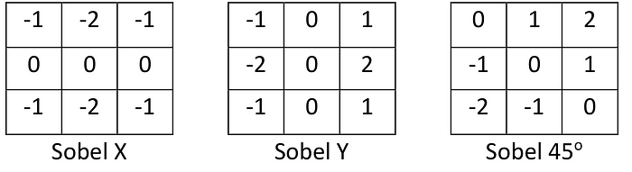
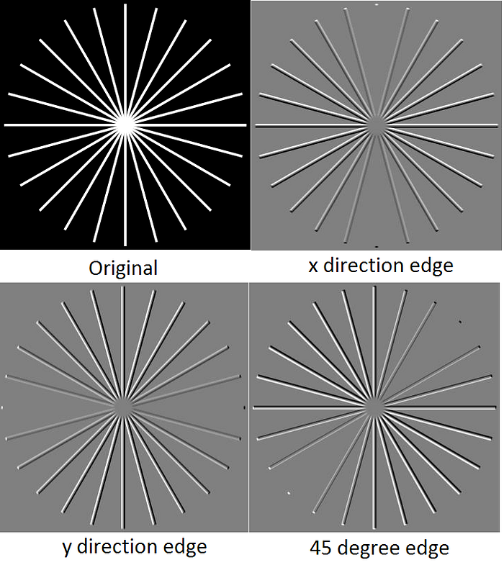
The Sobel operator
The Sobel operator the coefficients of masks are not fixed and they can be adjusted according to our requirement unless they do not violate any property of derivative masks.
It detects two types of edges
Horizontal edges
Vertical Edges
Edges are calculated by using difference between corresponding pixel intensities of an image.

Slide 21
Robert Operator
The Robert Operator is a simple edge detection operator used in image processing and computer vision.
It is named after Lawrence Roberts, who introduced it in the 1960s.
The Robert Operator is designed to detect edges by approximating the gradient of the image intensity.
Vertical Mask of Robert Operator:
Horizontal Mask of Robert Operator
+1 0
0 -1
0 +1
-1 0
Advantages:
simple and efficient.
detecting edges with a clear diagonal orientation.
Disadvantages:
It is sensitive to noise due to the small size of the convolution kernels.
may not perform well in the presence of diagonal edges in multiple directions.

Slide 22
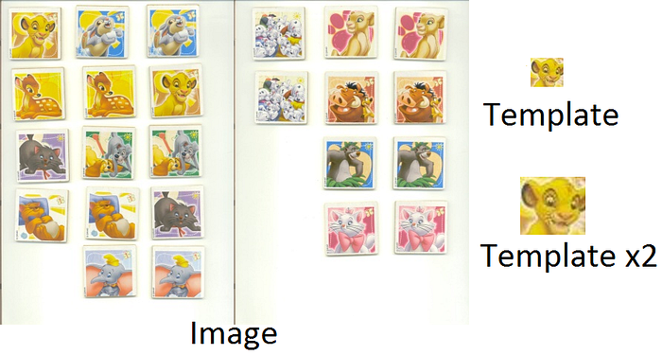
II. Template Matching
Template matching is used for detecting patterns or objects within an image.
template matching can be used to identify specific patterns or structures that represent edges.

Slide 23
III.COMPASS OPERATOR
It is an edge detection technique that employs a set of masks or filters based on different compass directions.
Each filter is designed to capture information about intensity changes in a specific direction.
The Compass Operator is especially useful for detecting edges that have different orientations.
North Direction Mask
North West Direction Mask
-1 | 0 | 1
-1 | 0 | 1
-1 | 0 | 1
0 | 1 | 1
-1 | 0 | 1
-1 | -1 | 0

Slide 24
III.COMPASS OPERATOR
West Direction Mask
South West Direction Mask
South Direction Mask
1 | 1 | 1
0 | 0 | 0
-1 | -1 | -1
1 | 1 | 0
1 | 0 | -1
0 | -1 | -1
1 | 0 | -1
1 | 0 | -1
1 | 0 | -1
South East Direction Mask
East Direction Mask
North East Direction Mask
-1 | -1 | -1
0 | 0 | 0
1 | 1 | 1
-1 | -1 | 0
-1 | 0 | 1
0 | 1 | 1
0 | -1 | -1
1 | 0 | -1
1 | 1 | 0

Slide 25
Line/Curve and Spot/Point Detection
Line detection in image processing involves identifying and extracting straight lines from an image.
It is Detected by Using Second Order Derivative Filter
+45⁰
Vertical Filter
-45⁰
Horizontal Filter
-1 | -1 | -1
2 | 2 | 2
-1 | -1 | -1
2 | -1 | -1
-1 | 2 | -1
-1 | -1 | 2
-1 | 2 | -1
-1 | 2 | -1
-1 | 2 | -1
-1 | -1 | -2
-1 | 2 | -1
2 | -1 | -1
Spot/Point Detection
Spot detection in image processing refers to identifying small, well-defined regions or points within an image.
-1 -1 -1
-1 8 -1
-1 -1 -1

Slide 26
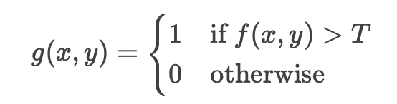
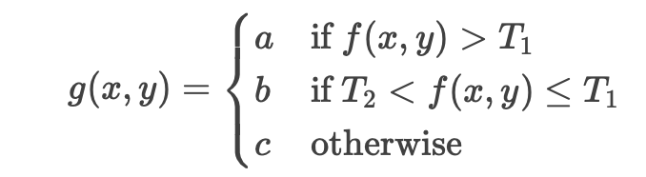
FEATURE THRESHOLDING
1. Amplitude Thresholding
Pixels are separated based on their intensity compared to a fixed threshold (T).
Binary Thresholding:
2. Thresholding Based on Histogram Statistics
Uses the image histogram to determine the threshold.
Peak/Valley Method: Find the lowest point (valley) between two peaks (foreground & background).
Otsu’s Method: Automatically selects the threshold by maximizing inter-class variance.
3. Multi-level Thresholding
Extends binary thresholding to multiple thresholds (e.g., for multiple regions).
Useful for images with more than two dominant intensity levels.

Slide 27
FEATURE THRESHOLDING
4. Local & Global Thresholding
Global Thresholding: A single threshold is applied to the entire image.
Local (Adaptive) Thresholding: varies across the image based on local intensity variations (useful for uneven lighting).
5. Optimum Thresholding
Uses statistical methods (e.g., Bayesian decision theory) to minimize classification errors.
Considers probability distributions of object and background intensities.

Slide 28
REGION DESCRIPTION & REPRESENTATION
Introduction to Representation:
This steps comes after the image segmentation.
Image segmentation turns the image into raw data and pixels deposited along the boundary or region
Representation is a naming process in simple word.
Applications of Representation :
Medical Imaging:
Object Recognition:
Remote Sensing:
Computer Vision and Robotics:
Image Compression:
Biometrics:
Computer Graphics:
Image Segmentation:

Slide 29
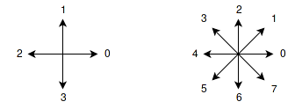
METHODS OF REPRESENTATION
Chain Codes/Crack Codes
Polygon Approximation
Signatures
Shape Numbers
Fourier Descriptors
Crack Code: Represents edges between pixels rather than the pixels themselves.
Chain Codes:
Chain code is a method of describing the shape of the boundary of an object in an image.
It is denoted by either a 4-connected neighbourhood or 8-connected neighbourhood

Slide 30
PROBLEMS WITH CHAIN CODES AND ITS REMEDY
Problems :
IF we change starting point the whole CC changes
If we use reflex image then also the whole CC Changes
IF we rotate the image then also the whole CC changes
Solution:
1. Finding cc
2. Finding the Circular First Difference [CFD]
3. Finally finding Normalize CC from CFD.

Slide 31
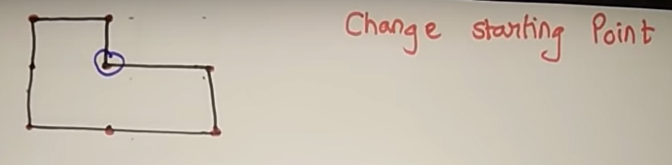
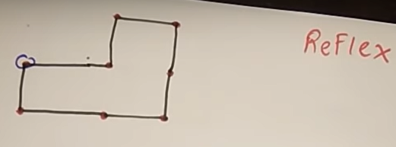
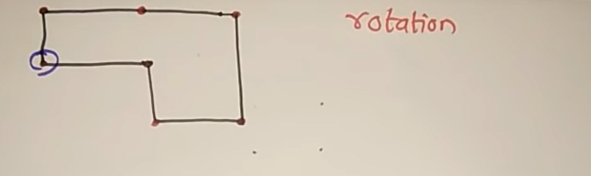

Slide 32
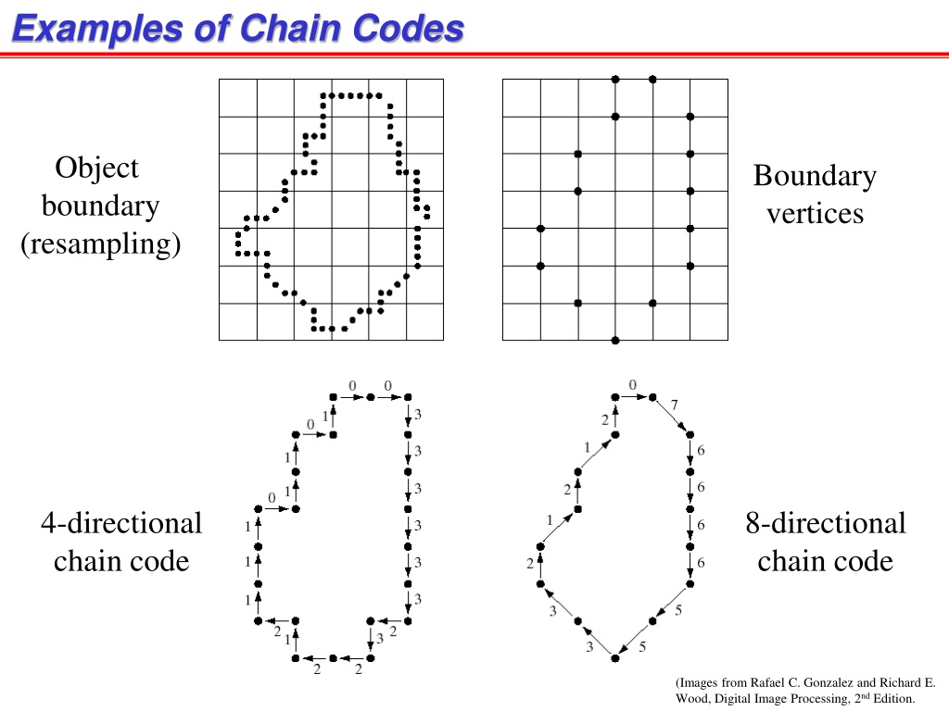

Slide 33

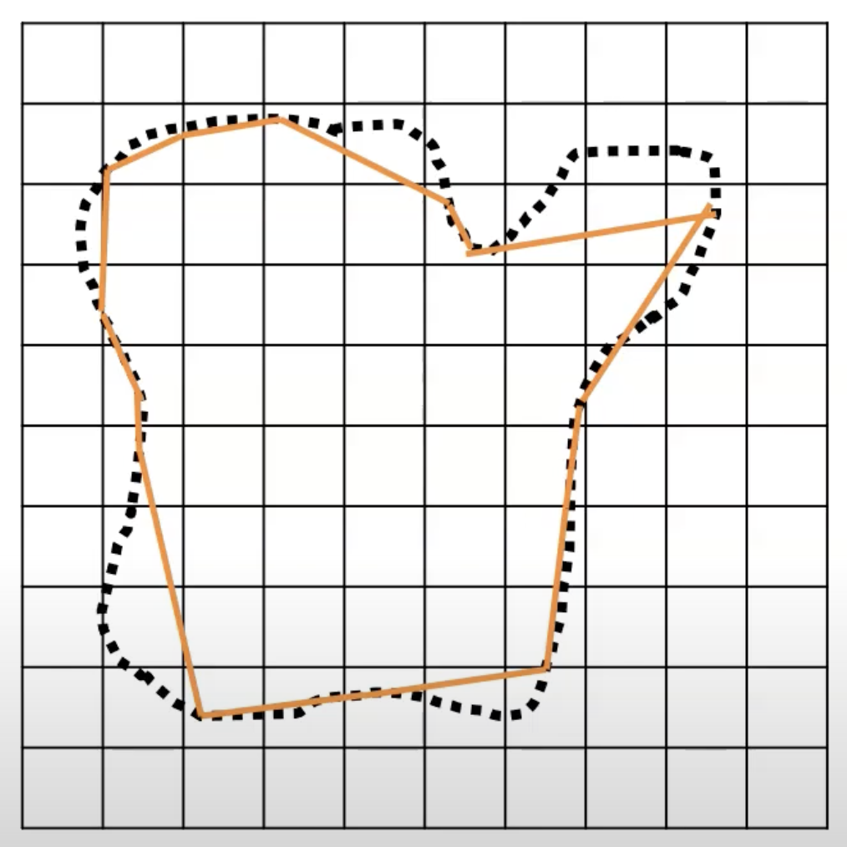
POLYGON APPROXIMATION
Image b
Image a

Slide 34
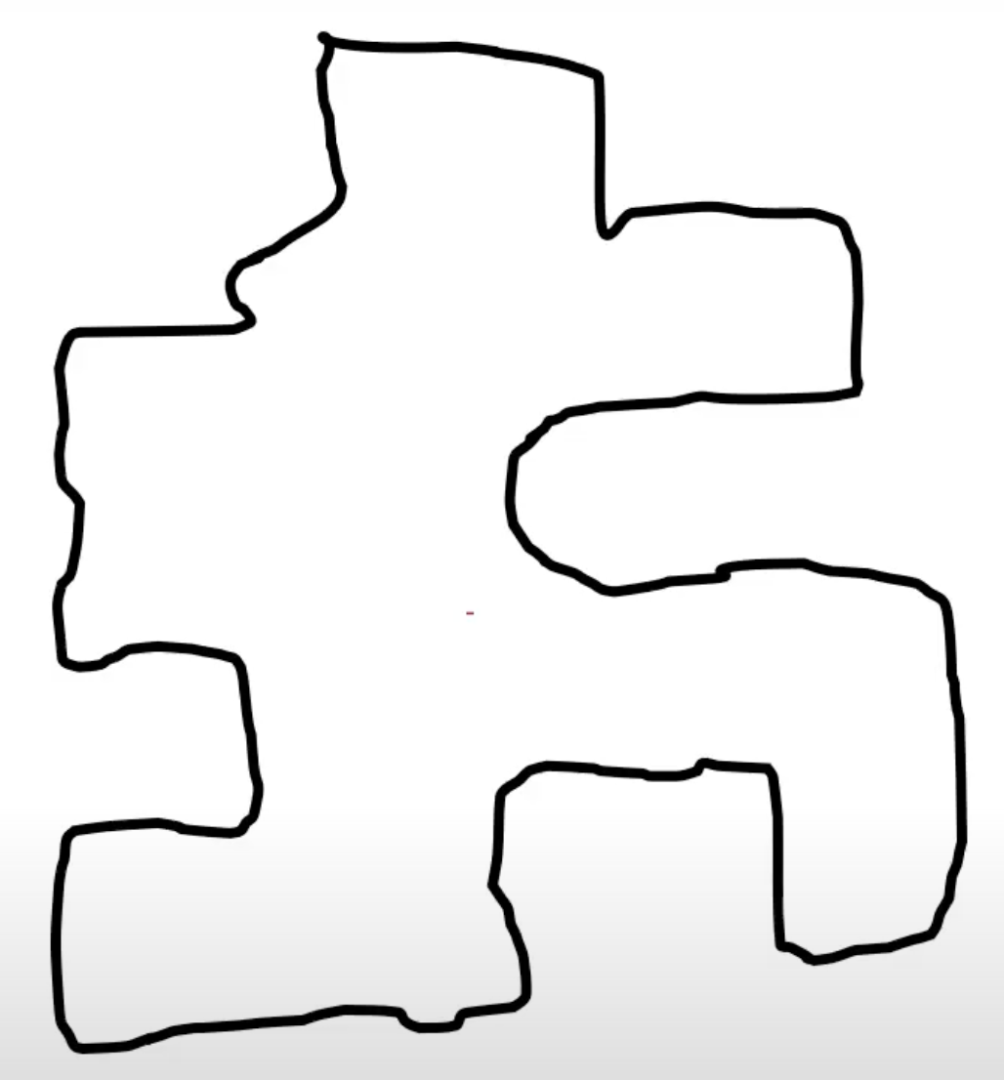
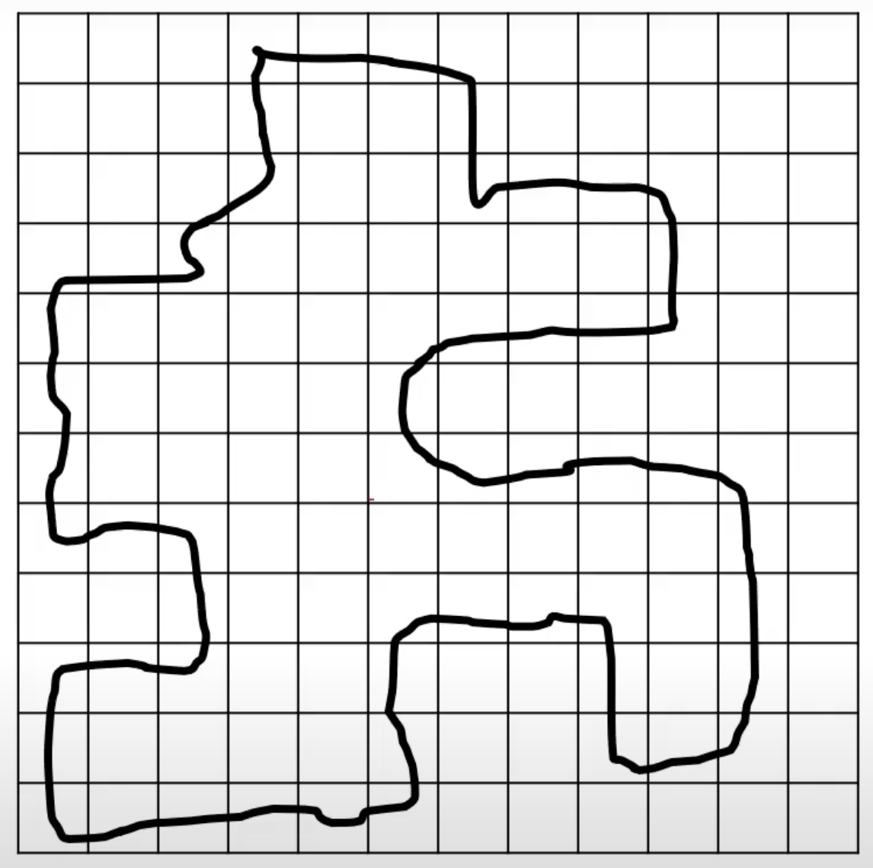
1. Minimum Perimeter Polygon

Slide 35
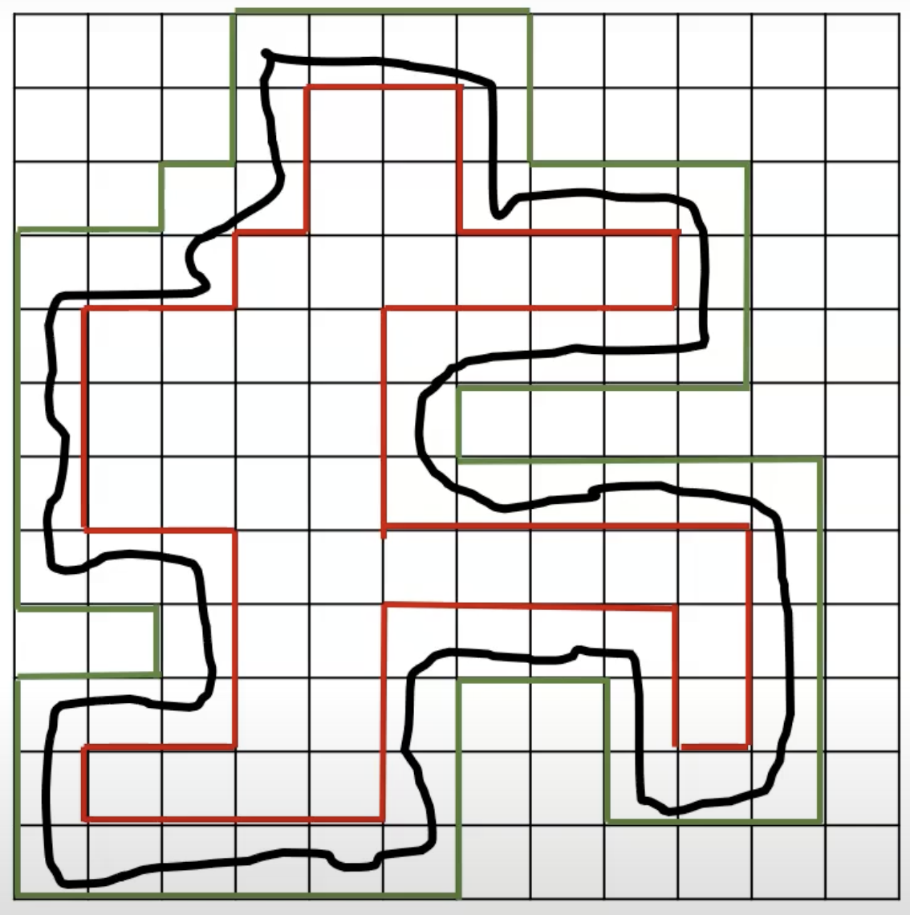
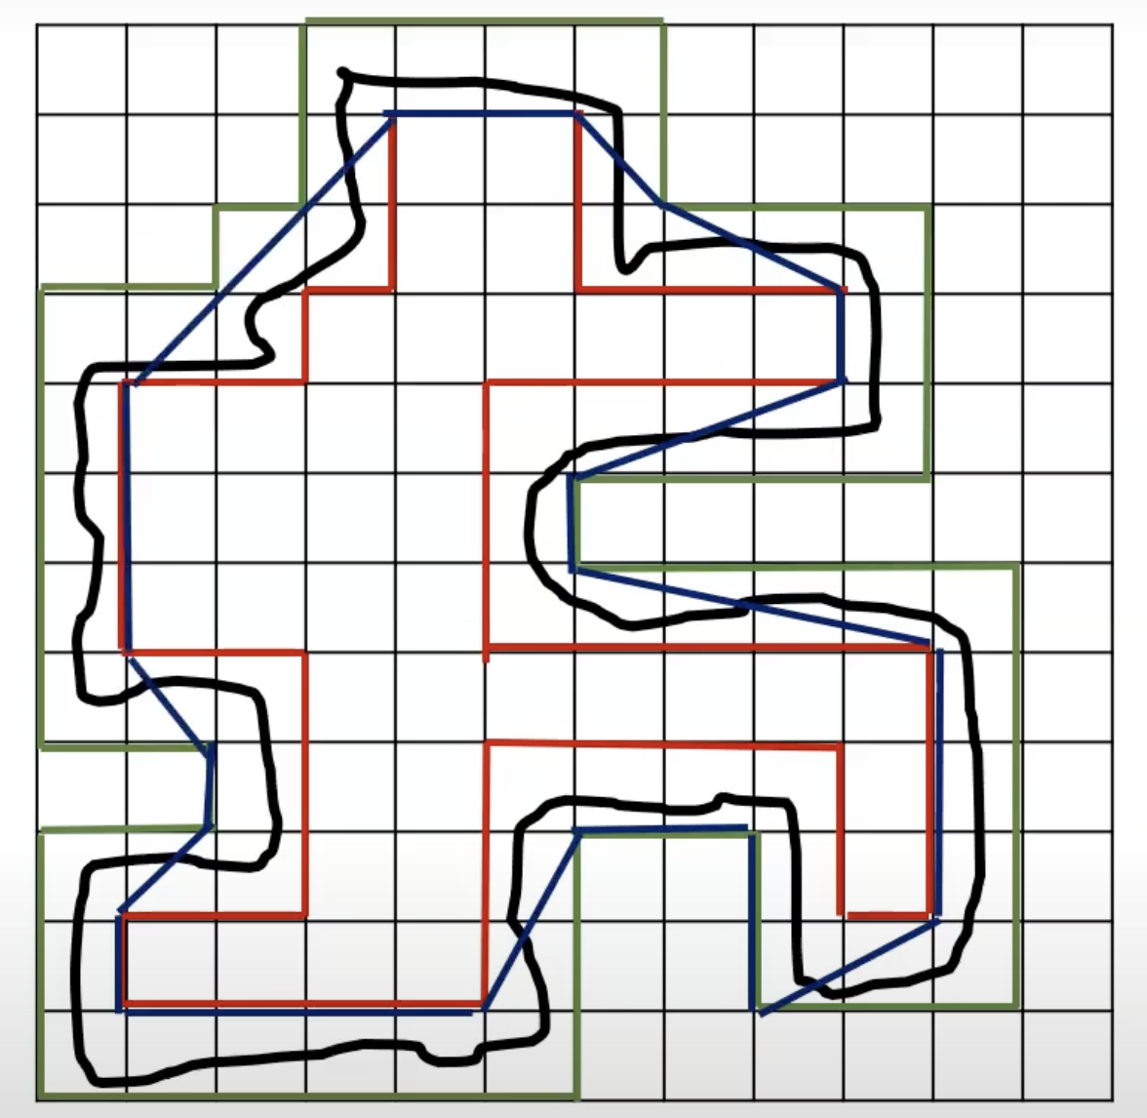
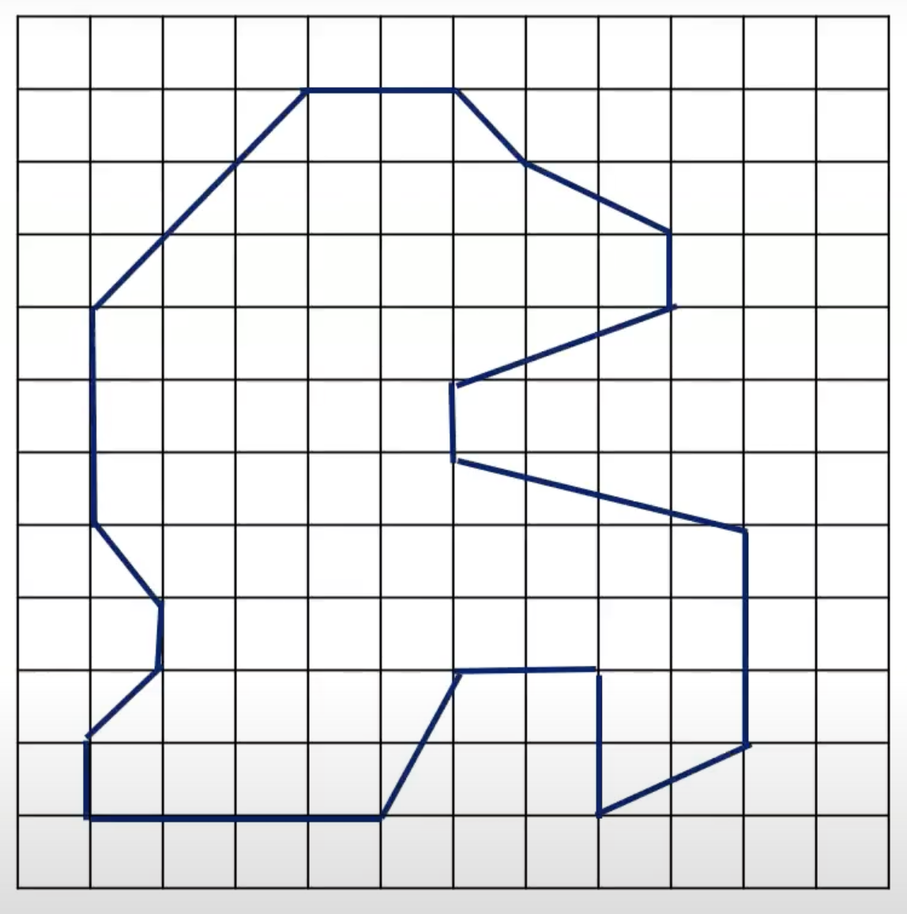
Minimum Perimeter Polygon

Slide 36
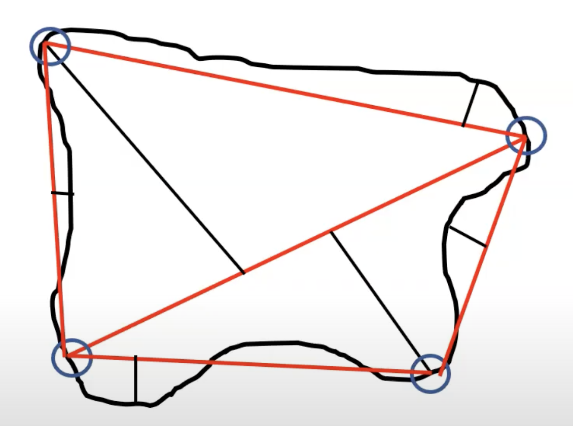

Splitting Technique
Works by plotting Perpendicular

Slide 37

Splitting Technique

Slide 38

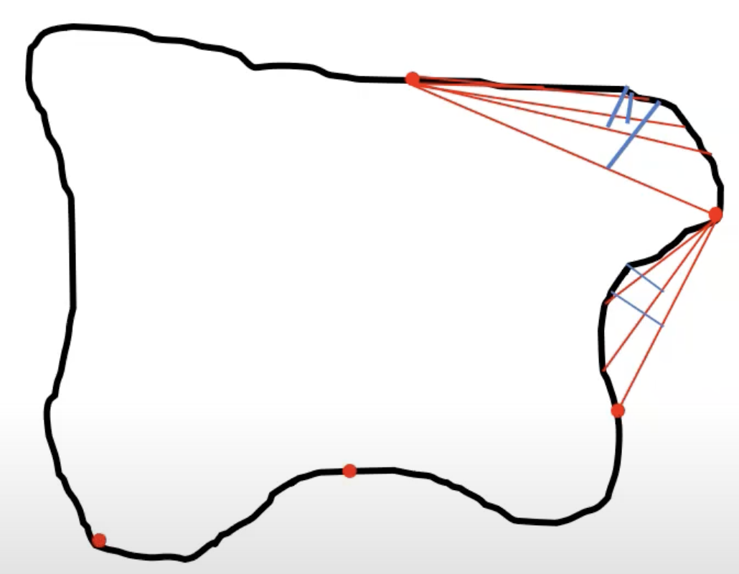
3. Merging Technique

Slide 39
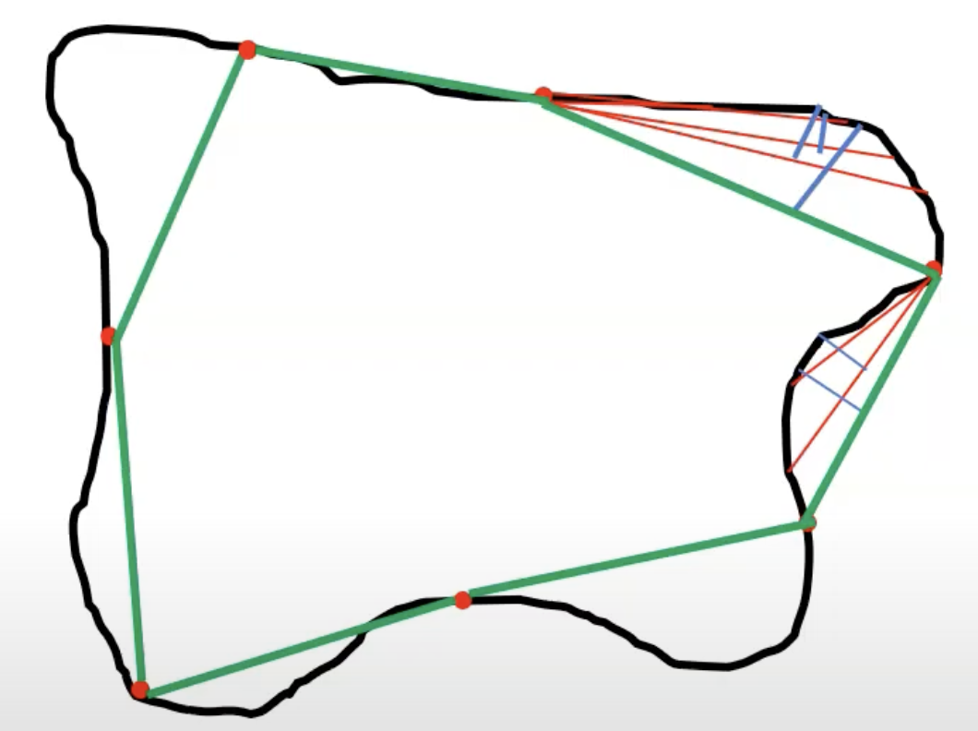
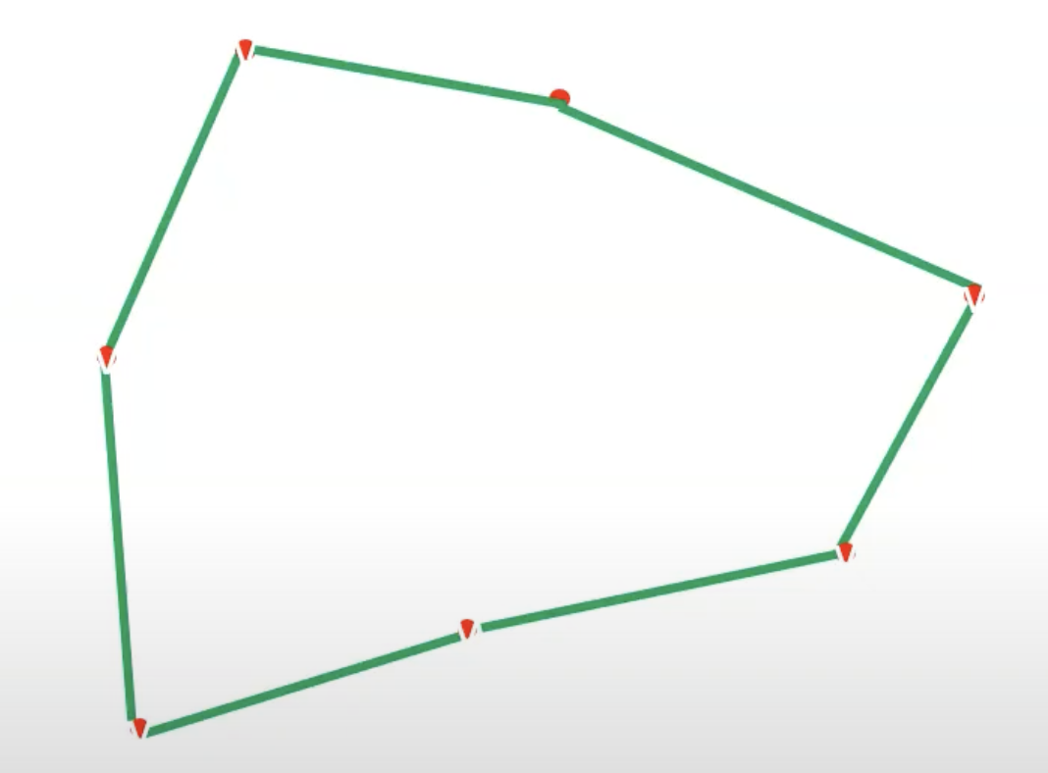
Merging Technique

Slide 40
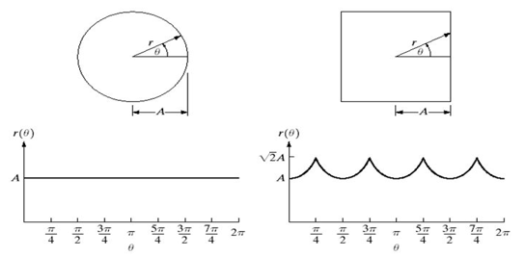
SIGNATURE
A 1‐D functional representation of a 2-D closed curved boundary of an object.
Signature is a plot of distance from the centroid to the boundary as function of angle.

Slide 41
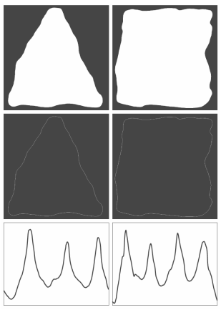
Irregular objects Signature's

Slide 42
DESCRIPTORS
Refers to features or characteristics that are extracted from an image to represent its content in a more manageable and meaningful way.
Two types of Boundary Descriptors:
Shape Numbers
Fourier Descriptors
first difference circular chain code.
Fourier Transformation of Complex Coefficient values.

Slide 43
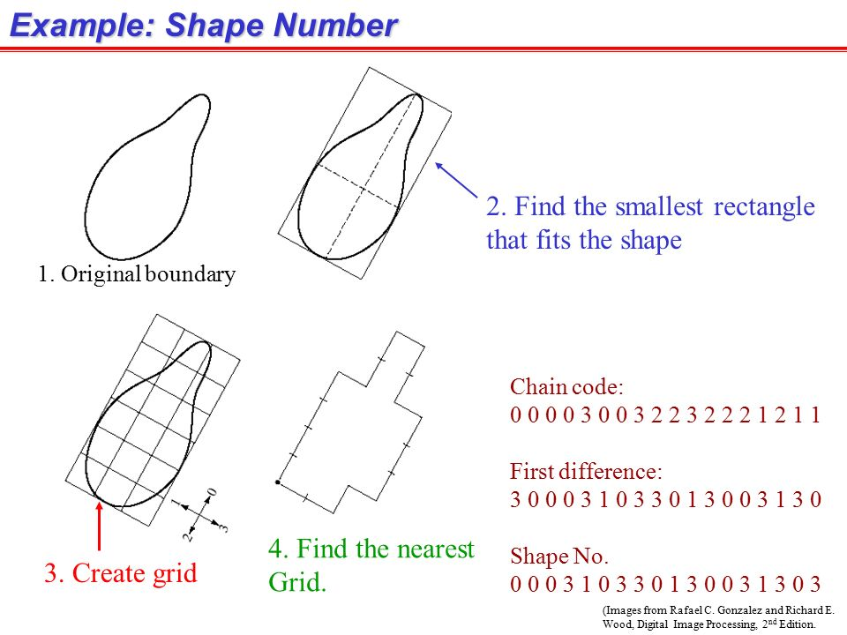

Slide 44
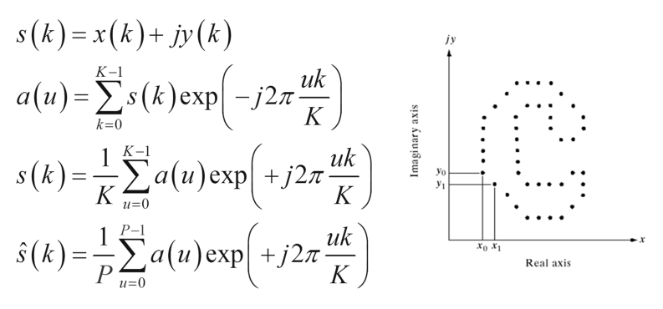
Fourier Descriptors
For all points in Given Image
DFT, Where a(u) is a complex coefficient which is called Fourier descriptors
IDFT to restore complex coefficient of s(k)

Slide 45

Fourier Descriptors
Instead of all a(u) just first p coefficient are used
Which is used to represent the boundary of image
Where u>p-1
Where P is preceding equation for a(u)
=Approximation to S(k)
It is used to represent the boundary with minimal points

Slide 46
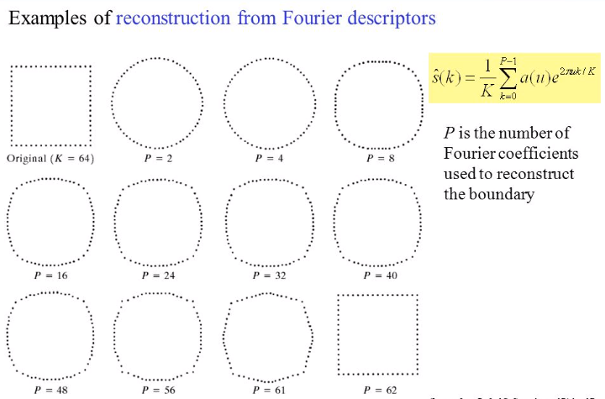
FOURIER DESCRIPTORS

Slide 47
End of Unit 6

Slide 48
THANK YOU

